Slide 1
How do we do Audio Tagging in 2021?
Speaker: zelin
Notes:
- Hi everyone! I’m your old friend Zelin.
Today I’m gonna talk about _____ .

Slide 2
Outline
Preliminary
Supervised
Audio only
Audio + Video
Self-supervised
Audio only
Audio + Video
Audio + Video + Text
Notes:
This is the outline of my talk.
- In 2021, state-of-the-art Audio Tagging approaches tend to exploit useful information from other modalities like Video and Text, rather than Audio itself.
So in this talk, I’ll start from traditional audio tagging methods, then I'll broaden our horizon to novel multi-modal approaches.
And since there are a bunch of papers in today’s talk, this time I would not go into the details of them, instead I will simply introduce their intuitions and results.

Slide 3
Outline
Preliminary
Supervised
Audio only
Audio + Video
Self-supervised
Audio only
Audio + Video
Audio + Video + Text
Notes:
In case you've forgotten what I have been doing, or you have never heard of audio tagging at all, I'll first introduce you some preliminary knowledge

Slide 4
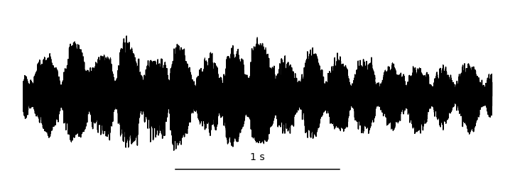
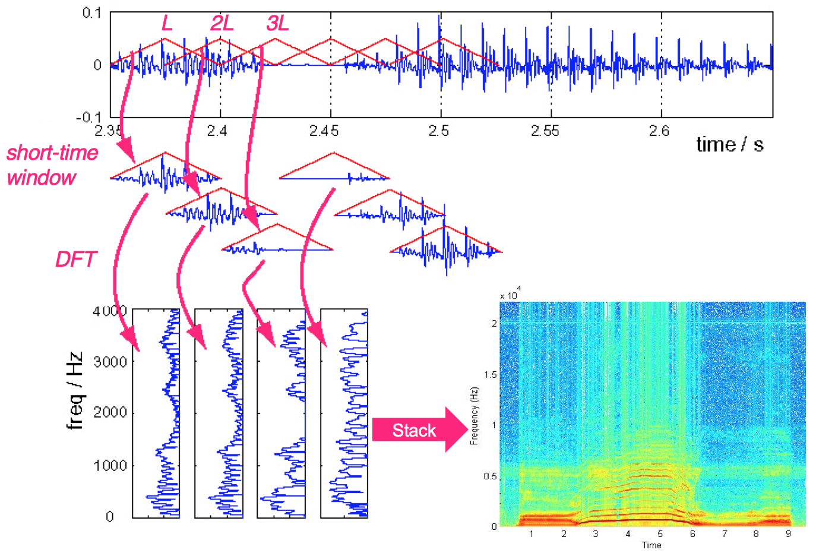
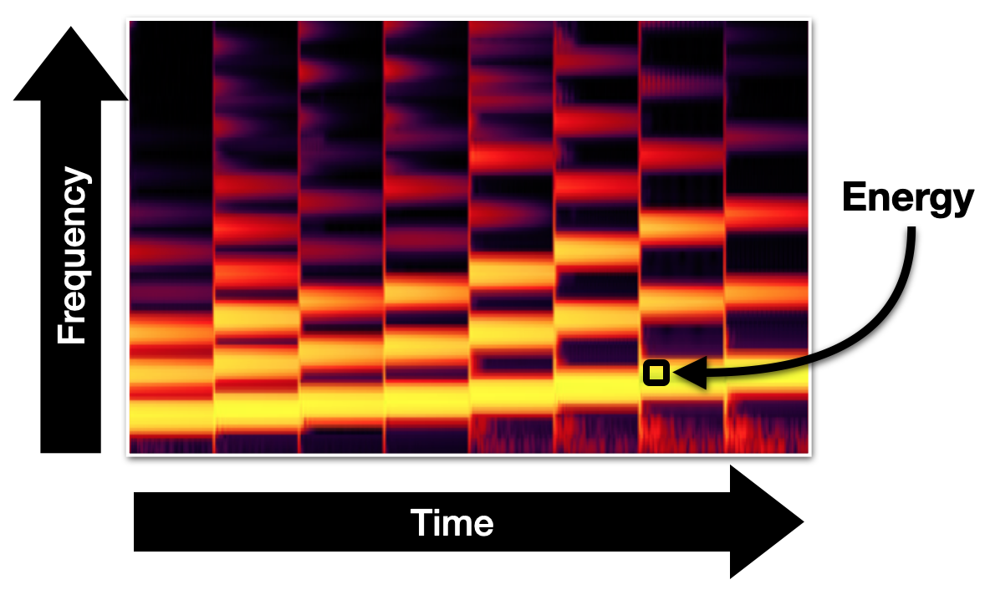
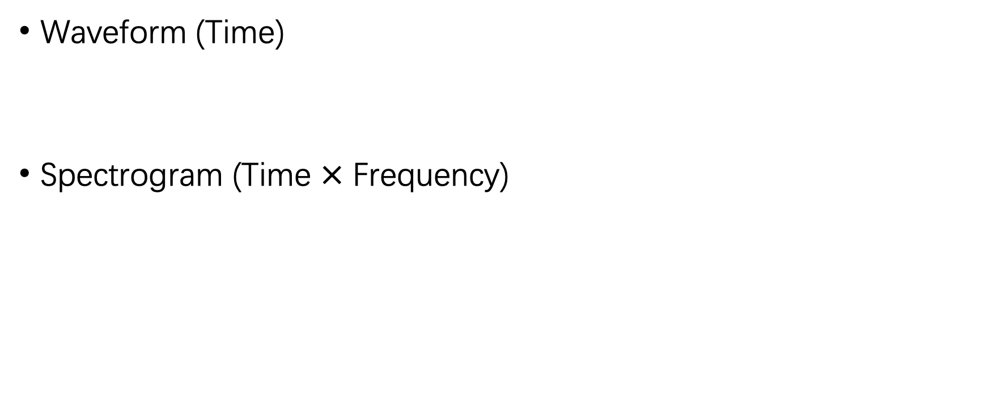
Representation of an Audio signal
Waveform (Time)
Spectrogram (Time $×$ Frequency)
STFT
Notes:
Given an audio signal, what is its digital representation before we input it into the Deep Neural Network?
- The most frequently used format is waveform. It is a single dimensional representation of an audio signal which only has time dimension. Those files with a suffix .wav is in this format.
In audio pattern recognition area, we can apply short time fourier transform to the original waveform, and get the spectrogram of an audio, which has two dimensions --- time and frequency.
STFT is like this.
- You don't need to fully understand this procedure, you should just remember that this one is the 1d waveform and this one is the 2d spectrogram. That's enough

Slide 5
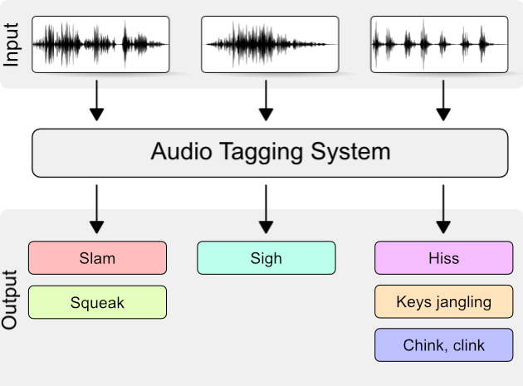

Audio Tagging
⇒ Audio tagging aims at predicting sound events occurred in a recording.
Multi-label classification
✅
Motorcycle
Water
Traffic noise and roadway noise
Birds chirping
Vacuum cleaner
Dog
Alarm
✅
Notes:
What is Audio Tagging. Audio Tagging ______, which is a multi-label classification problem.

Slide 6
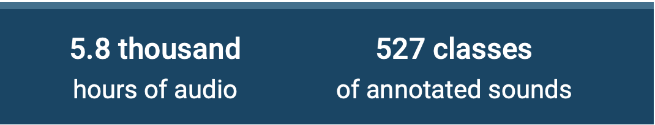
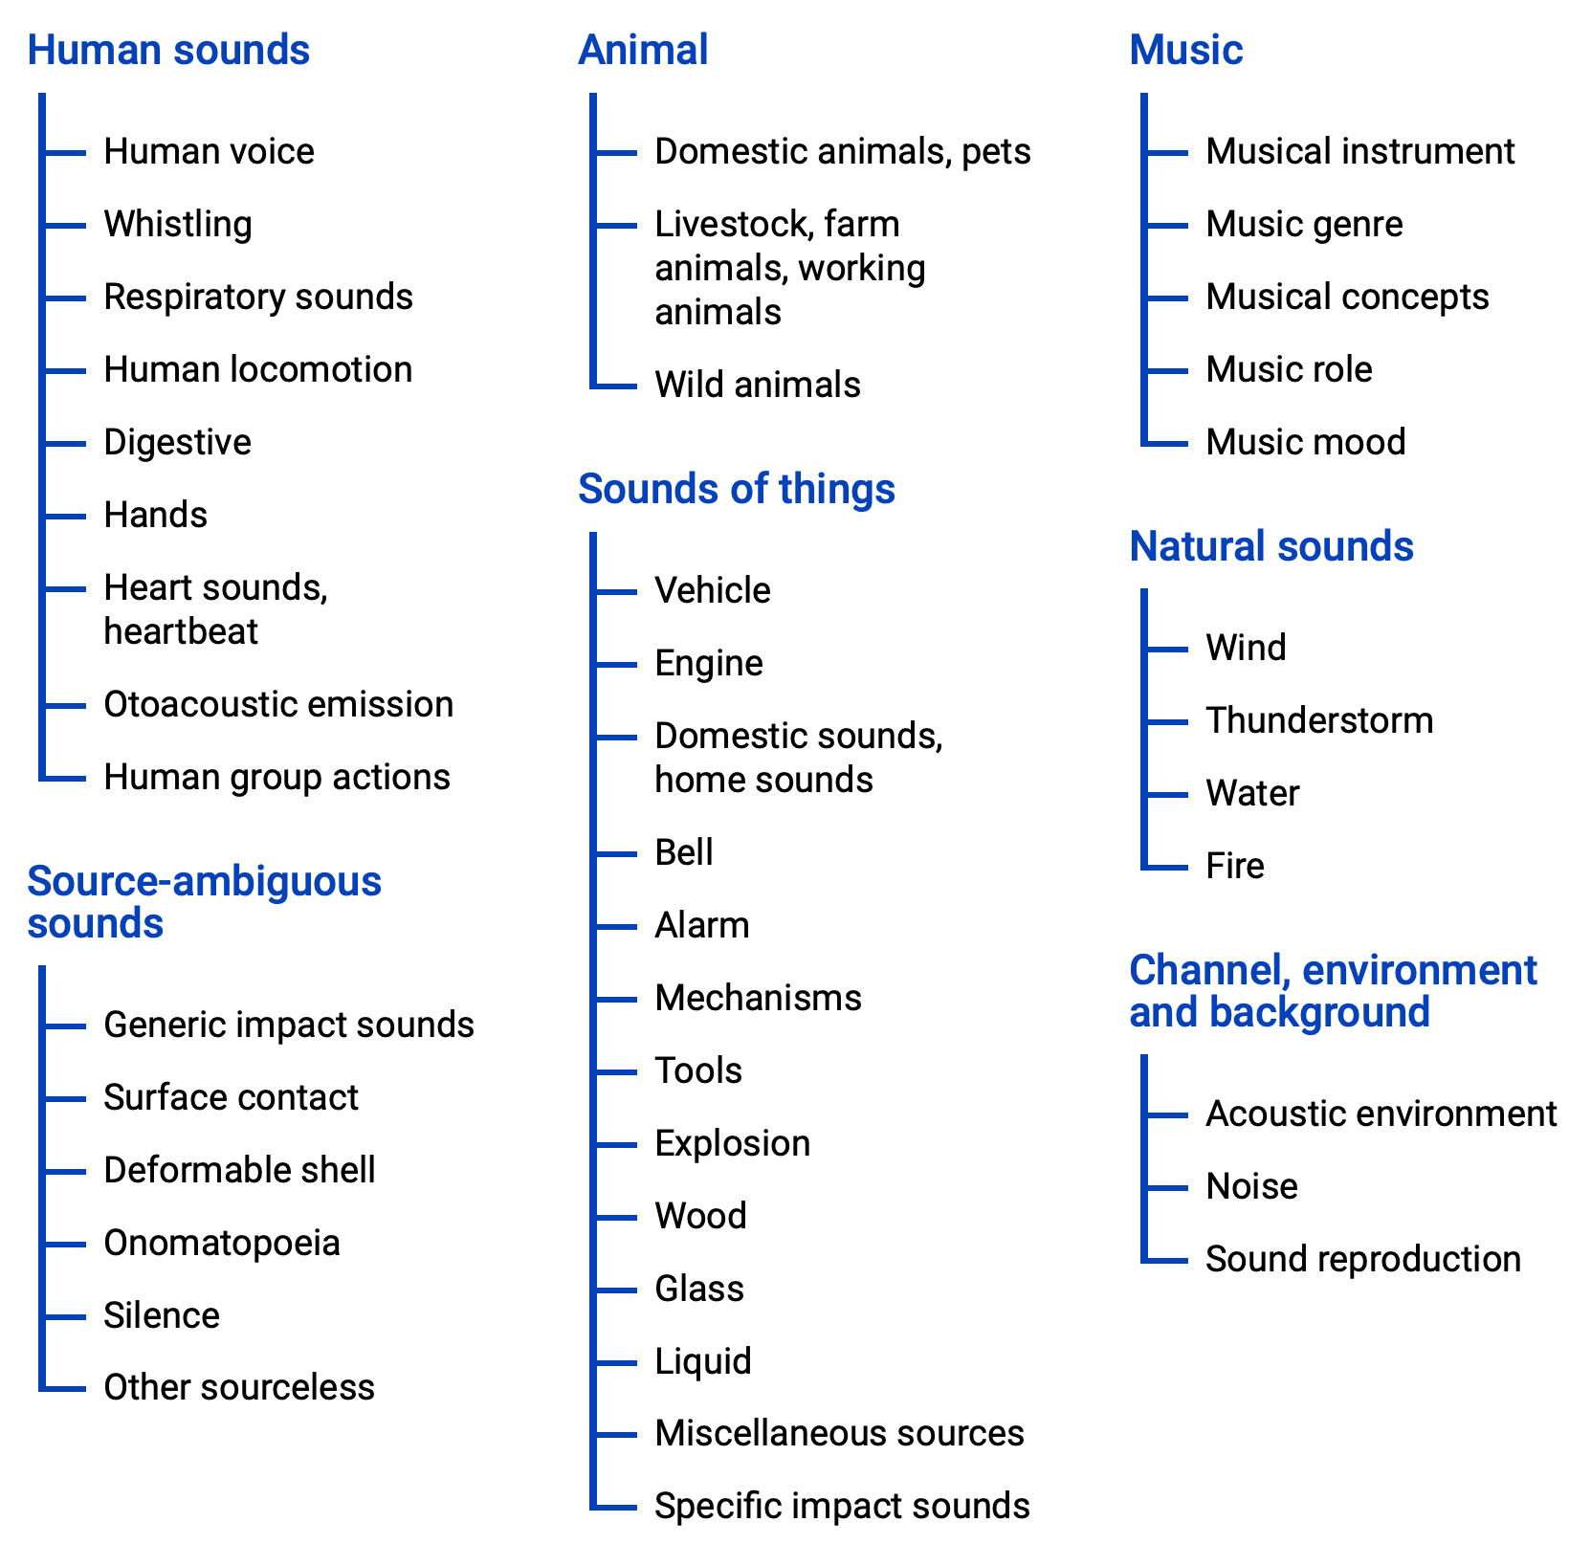

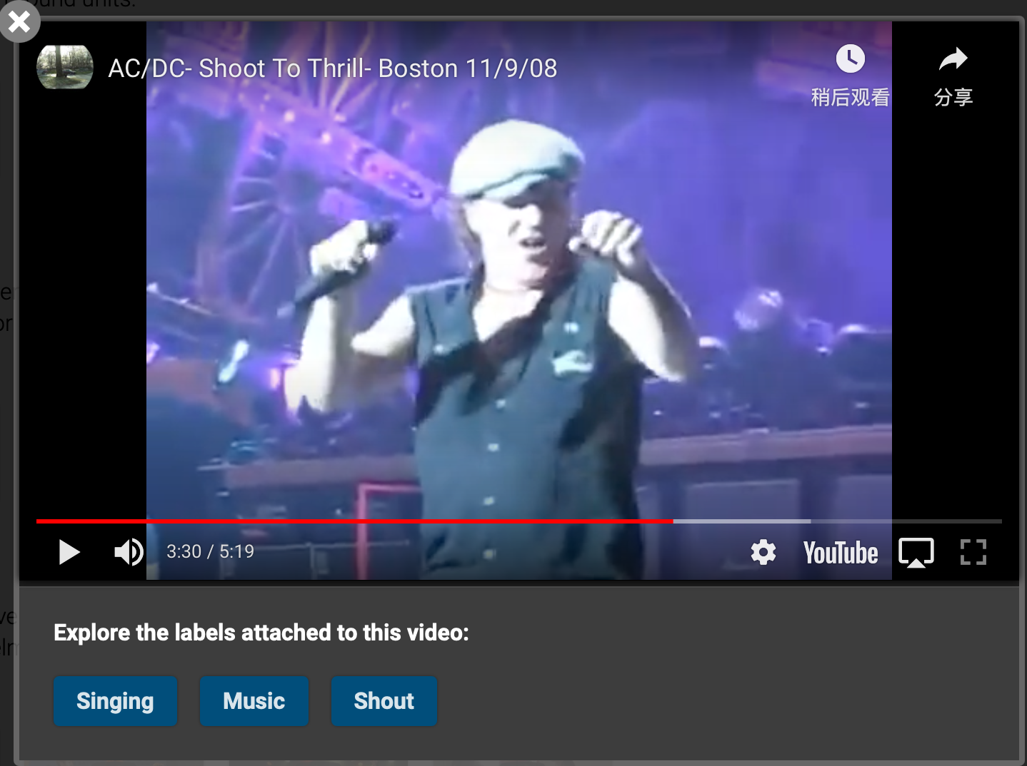
AudioSet
The largest sound vocabulary and dataset
Training Set:
Balance (20k)
Full (2m)
Eval set
Notes:
AudioSet is the largest sound vocabulary and dataset for Audio Tagging task, comprising of over 5 thousand hours of audios and 527 classes of annotated sounds
This is the hierachical ontology of the labels
And this is an example I cut from their official website. Note that each sample in AudioSet is a 10s audio clip extracted from YouTube. Below are the labels, here they are Singing, Music and Shout.
The whole AudioSet is divided into Training and evaluation set, in which training set is further divided into balanced train (which means there are roughly equal samples for any of the 527 labels), and full train
Today our topic will be centered with the Audio Tagging task on AudioSet, and all of our results are based on AudioSet evaluation set

Slide 7
Outline
Preliminary
Supervised
Audio only
Audio + Video
Self-supervised
Audio only
Audio + Video
Audio + Video + Text
Notes:
Next let's see the normal approaches using only Audio modality

Slide 8
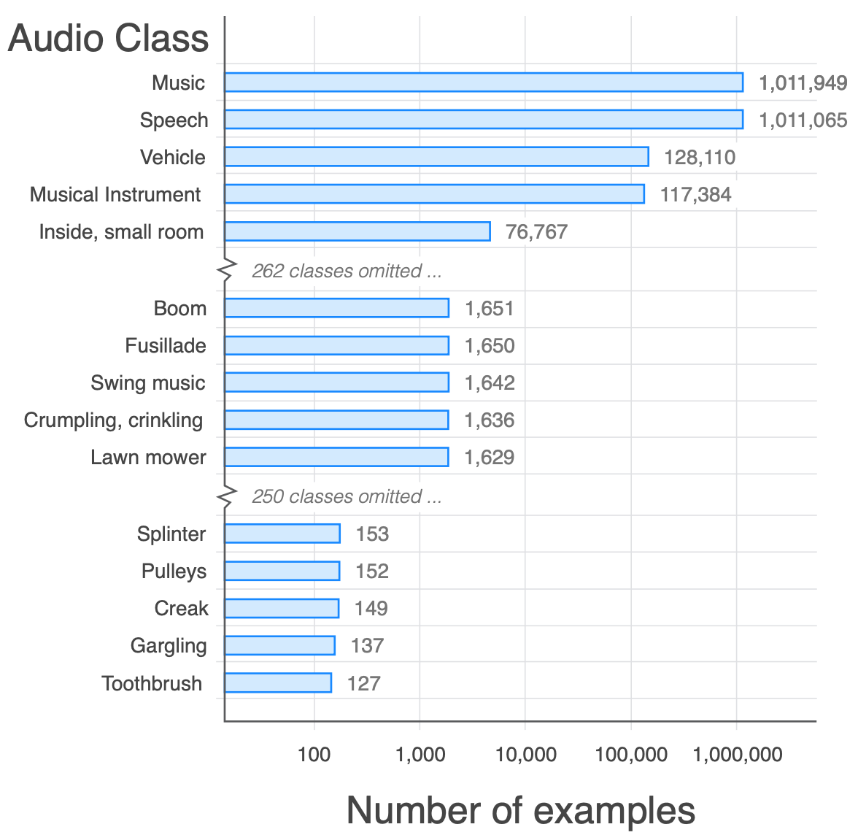
1. CNN (important backbone)
Pretraining CNN on AudioSet
Waveform → 1dCNN (DaiNet, LeeNet) → 527 labels
Spectrogram → 2dCNN (VGGish, ResNet) → 527 labels
Combining the two above ⇒ Wavegram-Logmel-CNN
Data processing ⭐️
Data Balancing
To solve long tailed distribution of labels
Data Augmentation
Mixup
SpecAugment
Notes:
- Since we can have 1d or 2d representation of an audio clip, the most convenient way classifying it into 527 classes is to adopt the commonly used deep neural networks from computer vision, for example AlexNet or ResNet
- In this paper called PANNs: _______, the main contributions are that they've tested all kinds of combinations applying CNN on AudioSet, like _____
- Another important contribution is that they've promoted two data processing methods in Audio Tagging
- One is _______
- Another is _______

Slide 9
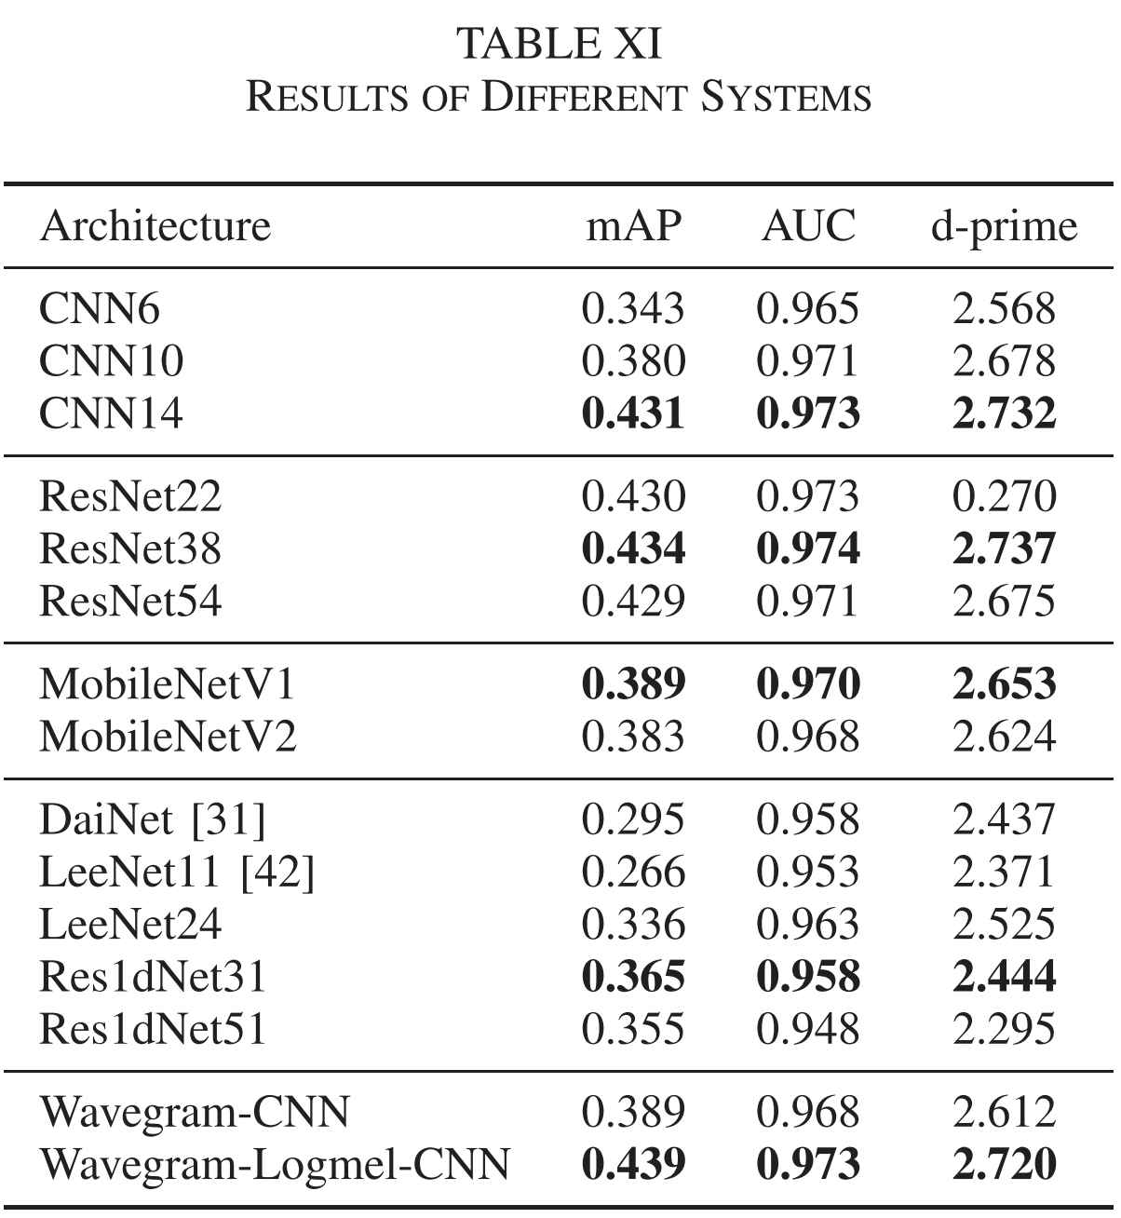
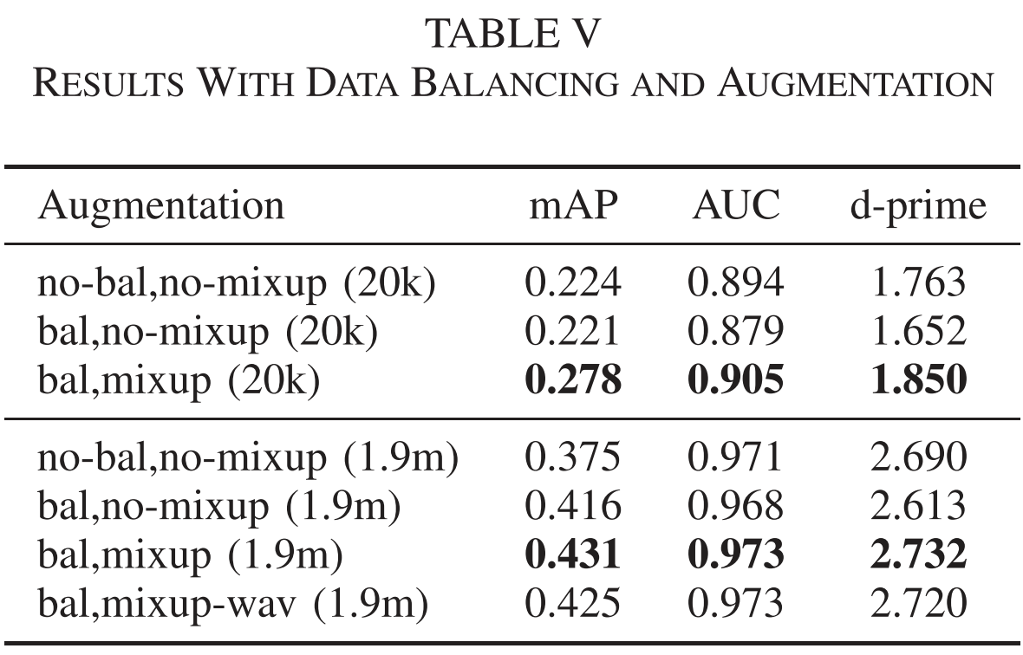
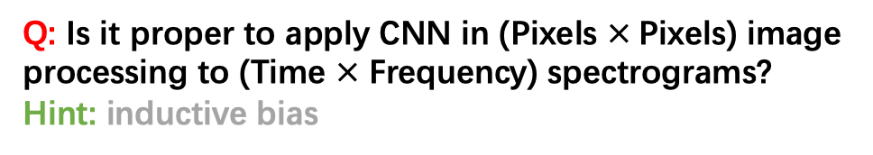
1. Results
Q: Is it proper to apply CNN in (Pixels $×$Pixels) image processing to (Time $×$ Frequency) spectrograms?
Hint: inductive bias
Notes:
- Here are the results on AudioSet. mAP means mean average precision, which is the default metric evaluating models' performance on AudioSet.
- We can see that with the two tricks, balanced dataloader and data augmentation, mAP increases significantly. On the right are performance of different model architectures, here we have another important finding that models using Spectrogram generally performs better than those using Waveform, which has become a commonsense in audio tagging task now.
- here comes the first quiz ---
A: translation invariance (spatial locality) doesn't work in spectrogram

Slide 10
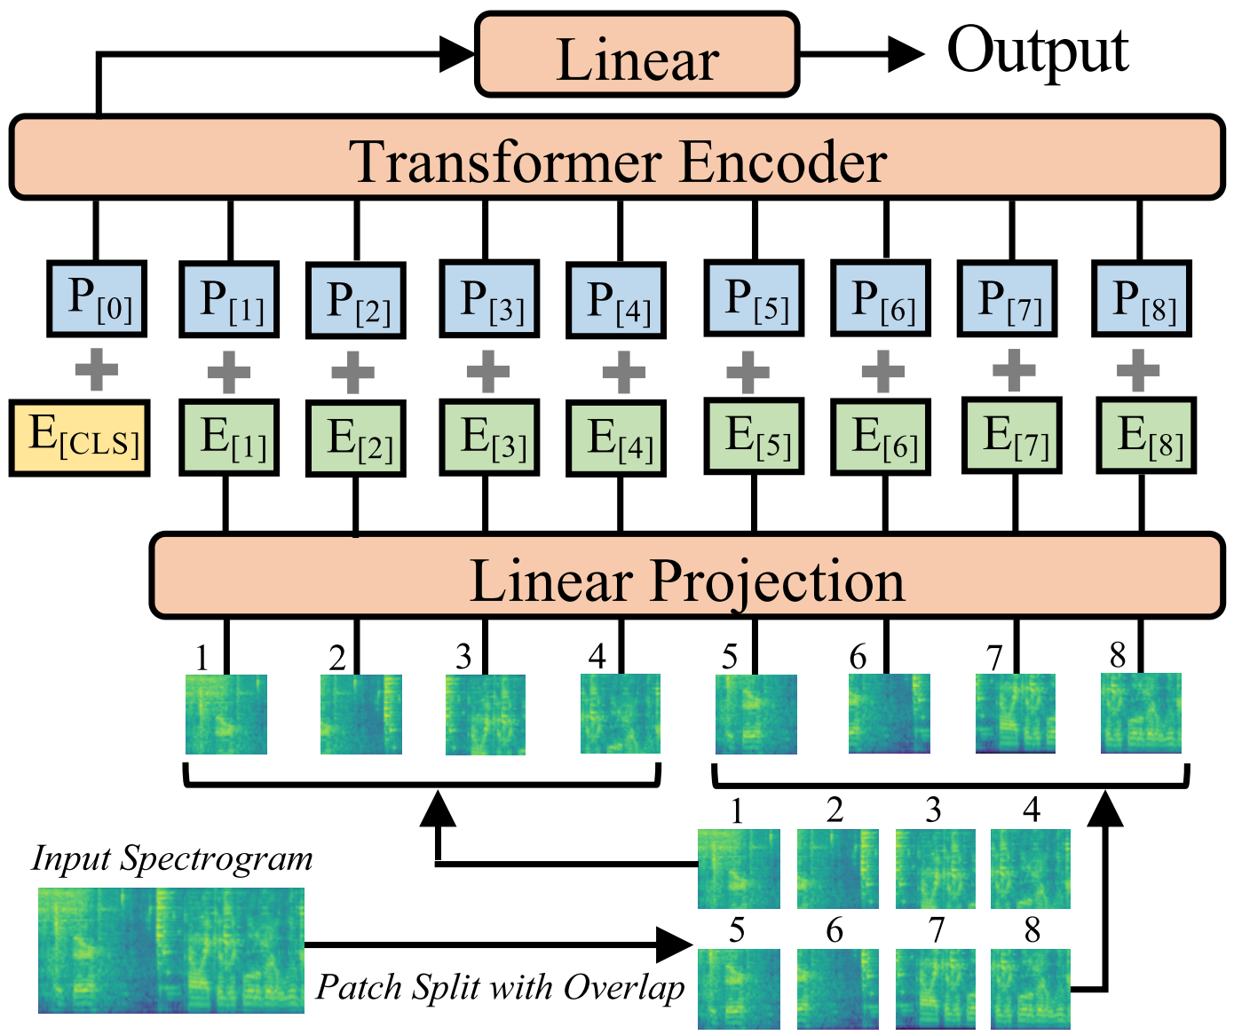
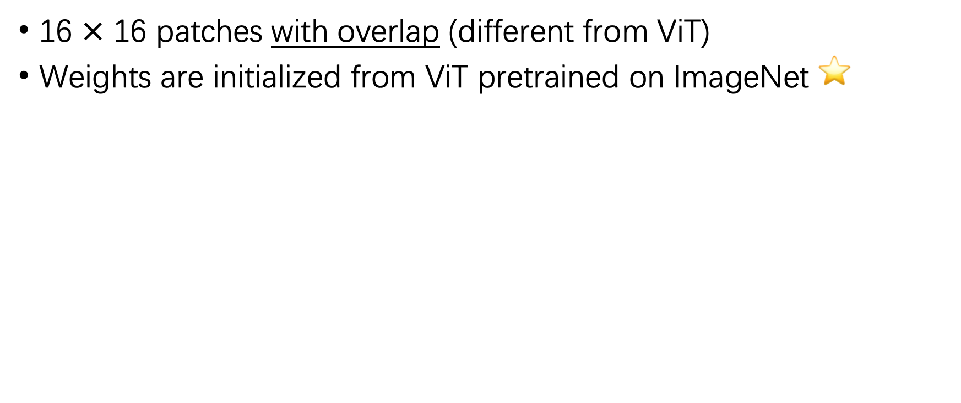
2. Transformers
16 $×$ 16 patches with overlap (different from ViT)
Weights are initialized from ViT pretrained on ImageNet ⭐️
Q: What is the advantage of AST compared with CNN regrading the input length?
Notes:
- We may turn to transformers to tackle such problems. Ever since the success of ViT in Computer Vision processing images, it is intuitive for us to apply similar architecture to its audio counterpart, which is the 2d spectrogram.
here the paper AST: ____
A: transformer can handle variable length of input

Slide 11
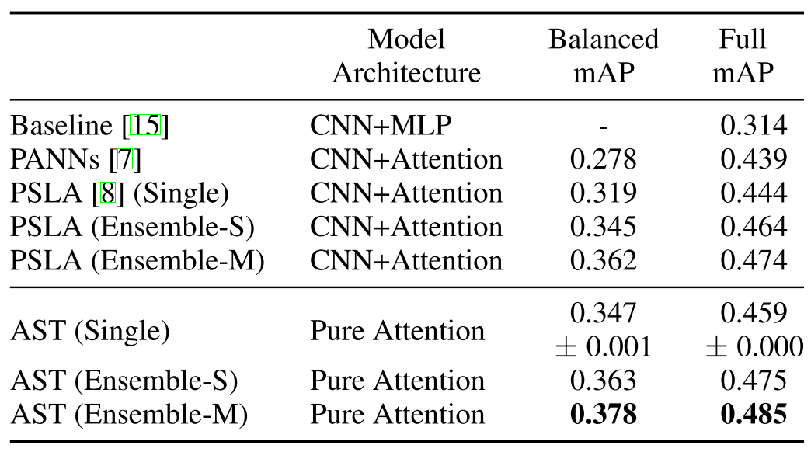
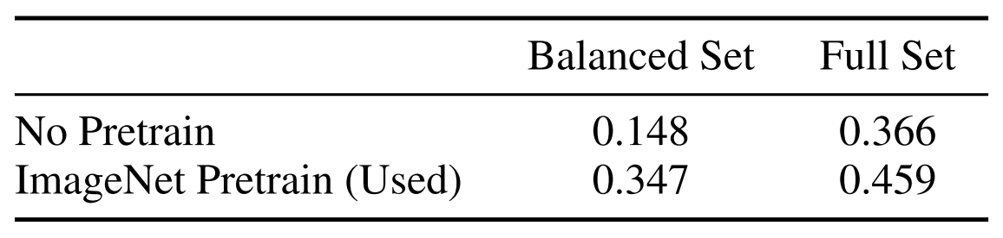
2. Results
PSLA is a training pipeline proposed by the author
Ablation
Notes:
Here are the results
PSLA is a _______, which is also applied to AST in this table
And, ablation results show the efficacy of the pretraining weights transferred from ImageNet, indicating that spectrogram could somehow be regarded as a kind of special image

Slide 12
Outline
Preliminary
Supervised
Audio only
Audio + Video
Self-supervised
Audio only
Audio + Video
Audio + Video + Text
Notes:
let’s go to the next part, Audio plus Video

Slide 13
Video? 🤔
Since the AudioSet is comprised of 10s audio clips extracted from YouTube videos
can we exploit the information from visual modality?
Notes:
Remember _____
The answer is YES

Slide 14
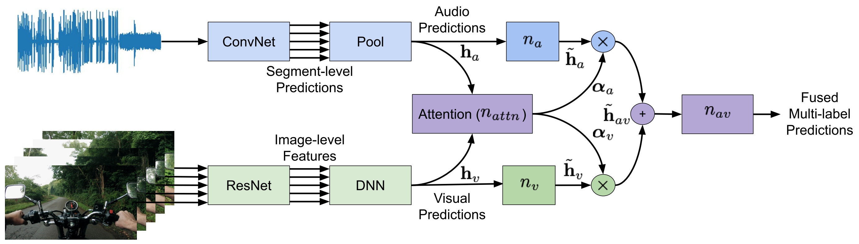
1. Attention Audiovisual Fusion
Fuse Audio and Video information via Attention
Audio waveform
Video frames
Notes:
A natural idea is to fuse ______ via attention mechanism
- Here in this paper called _______
- Audio Waveform and Video frames are input into their respective encoders and fused by a weighted sum using attention

Slide 15
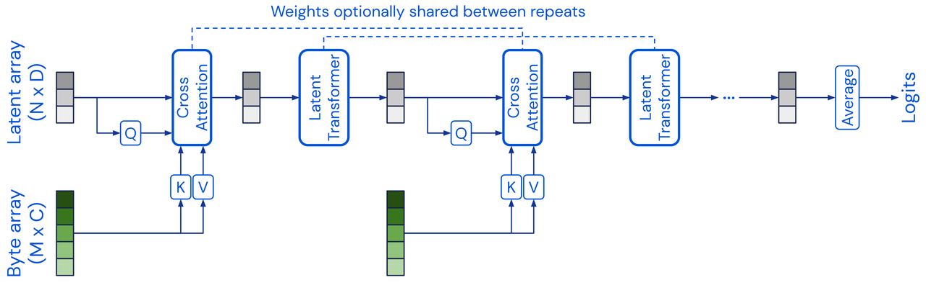
2. Iterative attention (Perceiver)
Modified attention mechanism (computation and memory saved)
K, V vectors are Iteratively input into the model
Single Transformer-based architecture to handle arbitrary configurations of different modalities (Audio, Video, Point-Cloud)
Notes:
- Unlike the previous paper which encodes audio and video respectively and fuse them in the end,
this paper called Perceiver utilized a variety of attention mechanism,
and iteratively fuse the audio and video modalities’ K,V vectors before each latent transformer layer.
The aim of Perceiver is to design a _____
As is indicated by the name, it perceives the world like what our human does

Slide 16
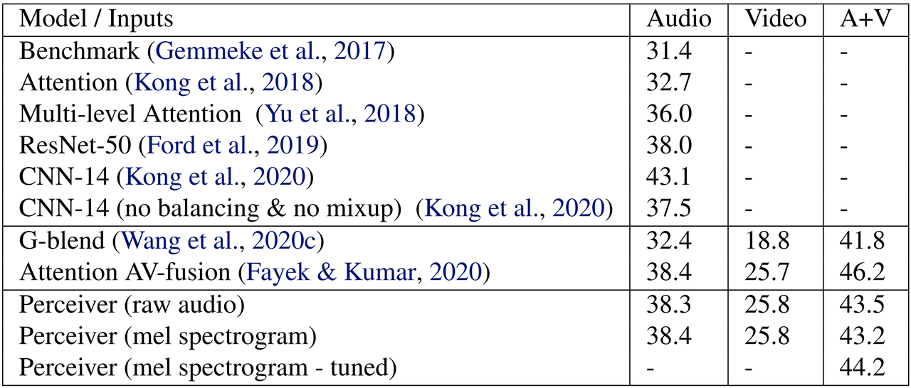
2. Results
Note: only SpecAugment is used in Perceiver

Slide 17
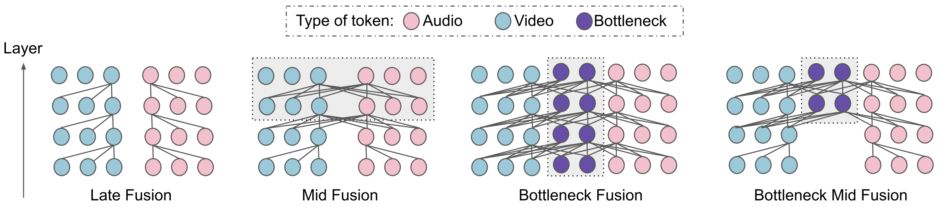
3. Multimodal Fusion Strategies
Early (Perceiver)
Mid
Late (Attention AV Fusion)
Bottleneck Fusion:
Audio and Video modality interact with the intermediate nodes in succession
Q: Can you think of an advantage of bottleneck fusion
compared with traditional fusion strategies?
Notes:
We can summarize two types of multi-modal fusion strategies from the previous two papers
- Which is late fusion represented by attention AudioVisual fusion
- and early fusion represented by perceiver
- there could also be Mid fusion which fuses two modalities at the bottom few layers
- in this paper the authors proposed another fusion strategy apart from traditional ones, called bottleneck fusion, in which Audio and Video modality ____
A:
Different granularity
Reduce the computation costs

Slide 18
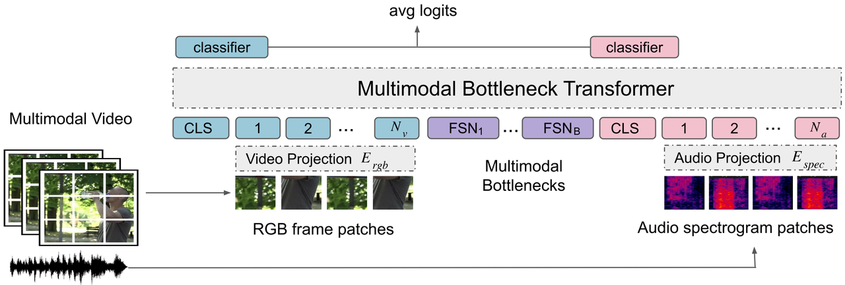
3. Methods
Notes:
- Here is their pipeline.
- Both Video and Audio are encoded with transformer architecture and input into multimodal bottleneck transformer.
- output logits are averaged in the end for predictions

Slide 19
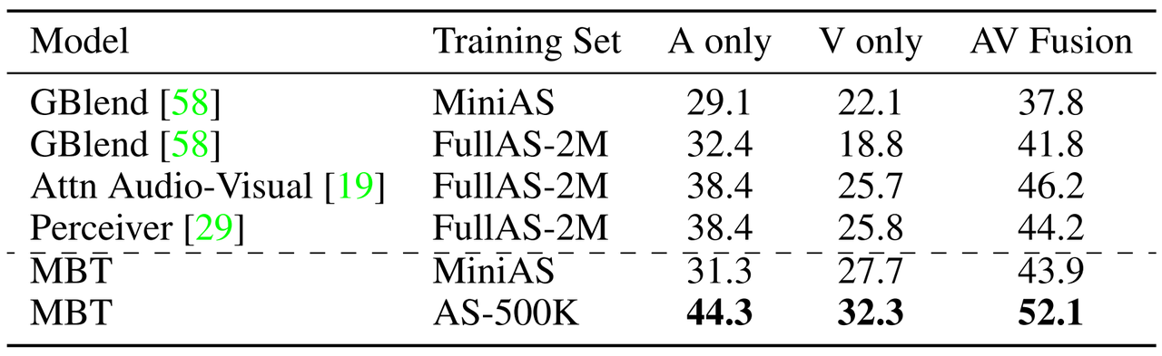
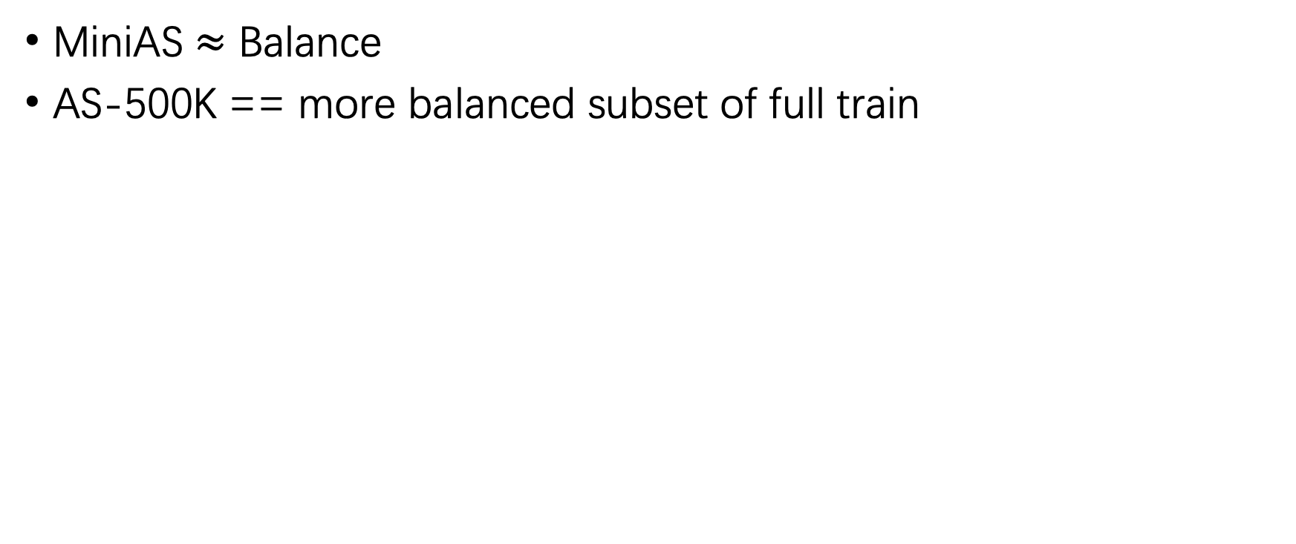
3. Results
MiniAS $≈$ Balance
AS-500K == more balanced subset of full train
Notes:
- Here are the results
- MiniAS could be regarded as AudioSet Balanced train, and AS-500K is a more balanced subset of full train
- The authors claimed that they used only a quarter of full train samples to achieve the best, significantly outperforms previous SOTA
- and this paper yields the best performance on AudioSet since June of 2021

Slide 20
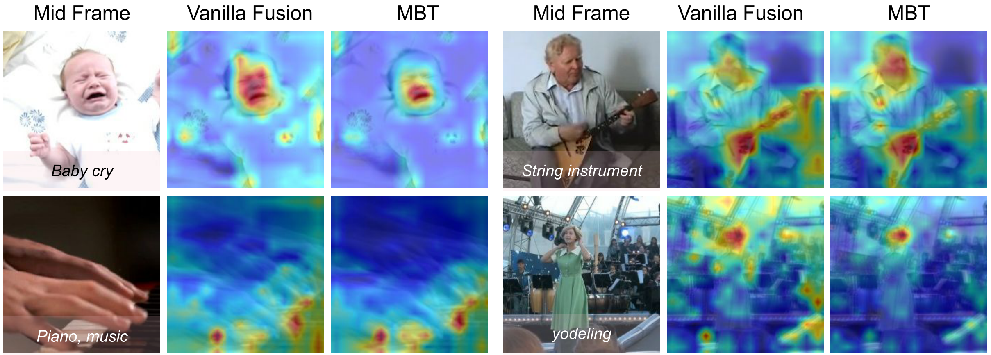
Visualization
Notes:
With the visualization heatmap we can find that MBT could focus more on the part of an image which produces sound, like the mouse of a baby when crying, and the mouse of a singer who is yodeling

Slide 21
Outline
Preliminary
Supervised
Audio only
Audio + Video
Self-supervised
Audio only
Audio + Video
Audio + Video + Text

Slide 22
Recall Multimodal Fusion Strategies
Manual labeling is heavy and expensive [1]
Early (Perceiver)
Mid
Late (Attention AV Fusion)
What if there is no label, and no fusion at all? 🤔
Notes:
- There are various kinds of fusion strategies, however they are all supervised and human annotation is needed
- As is revealed in my paper, ______

Slide 23
Fusion strategies
Early (Perceiver)
Mid
Late (Attention AV Fusion)
What if there is no label, and no fusion at all? 🤔

Slide 24
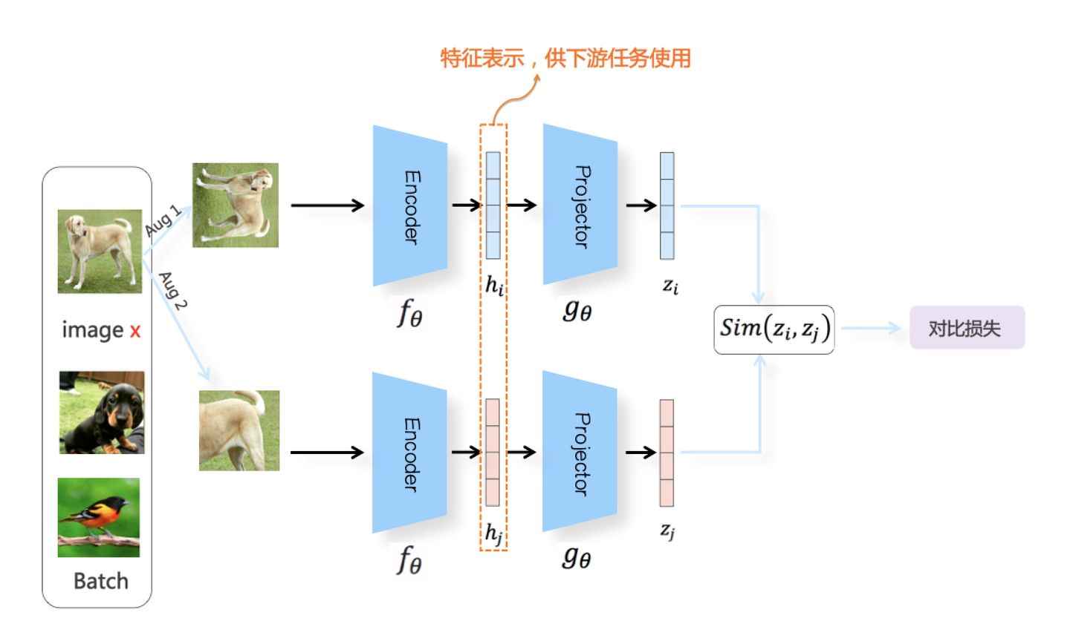
Contrastive learning
Q: Given a positive pair, how many negative pairs can we form? (N samples in a batch)
2(N-1)
Positive pair
SimCLR
Negative samples
Notes:
In case some of you are not familiar with contrastive learning, let me first introduce it with SimCLR, a standard contrastive learning architecture in computer vision.
- Given a batch of images,
- When forming a positive pair, one image is derived into two augmentations, here we call them aug1(rotate) and aug2(crop)
- aug1 and aug2 goes into their own encoders and get the feature vectors
- Then the feature vectors are projected into another space
- we calculate the similarity of two vectors. the function could be cosine similarity or bilinear or something else
- contrastive loss is calculated in the end.
- SimCLR uses InfoNCE loss, which means augmentations of the same image are positive pairs
- while other images in the same batch are negatives samples

Slide 25
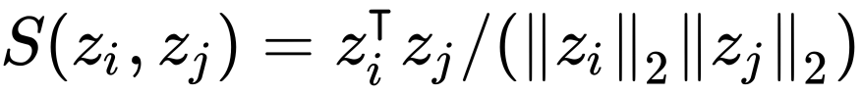
Contrastive learning
Loss function
Cosine Similarity of two samples
Positive pairs (Pull together)
Negative pairs
(Push away)
Notes:
- We can see how contrastive loss works from the equation
分子：numerator
分母：denominator

Slide 26
Audio & Audio
Notes:
- Now that we have the Bi-encoder architecture and contrastive loss, we can alter the images with elements from other domains.
- For example we can change the images to audio spectrogram, and apply the audio specific augmentation techniques like SpecAugment

Slide 27
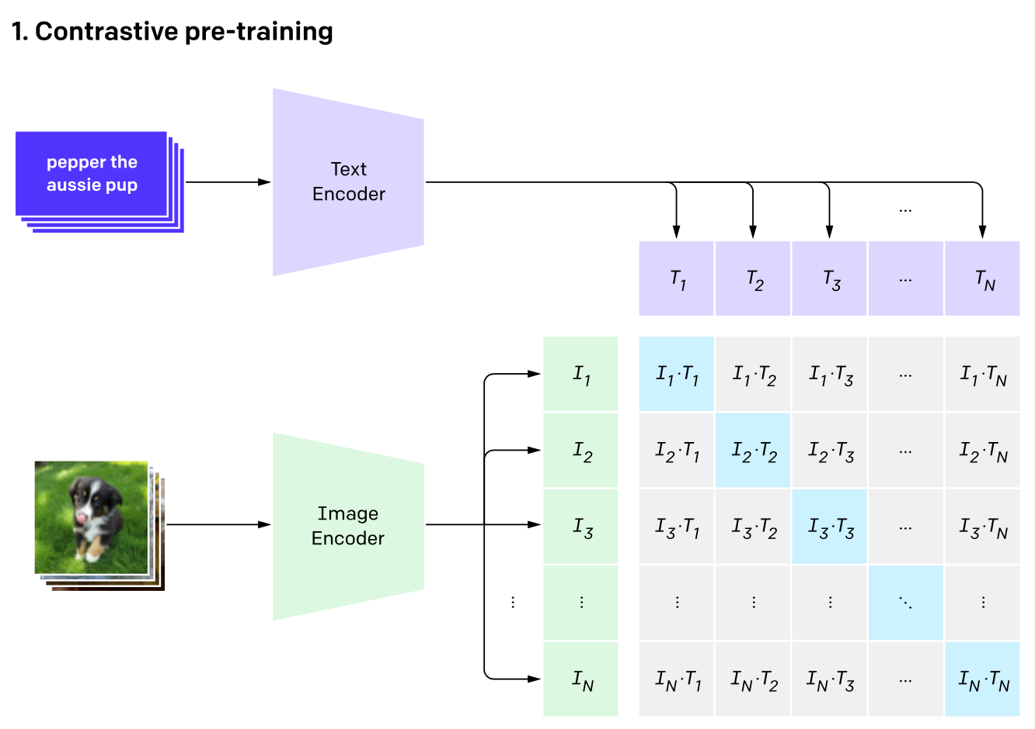
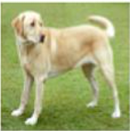
Image & Text
Q: Given a positive pair, how many negative pairs can we form? (N samples in a batch)
N-1
CLIP
(image, caption)
A dog standing on the grass
Notes:
We can even expand this paradigm to multi modalities, for example the elements in a batch could be (image, caption) pairs.
the above branch is the original image , while the bottom branch goes its corresponding description “_____”, other components remain the same.
And this is exactly what the famous CLIP model does!

Slide 28
Image & Audio
Video frame
Video
Audio Spectrogram
Notes:
Similarly, we can alter the elements with video clips
While branch one goes a frame cut from the original video, branch two is its corresponding audio spectrogram
Let’s see how these ideas are implemented and help the audio tagging task

Slide 29
Outline
Preliminary
Supervised
Audio only
Audio + Video
Self-supervised
Audio only
Audio + Video
Audio + Video + Text

Slide 30
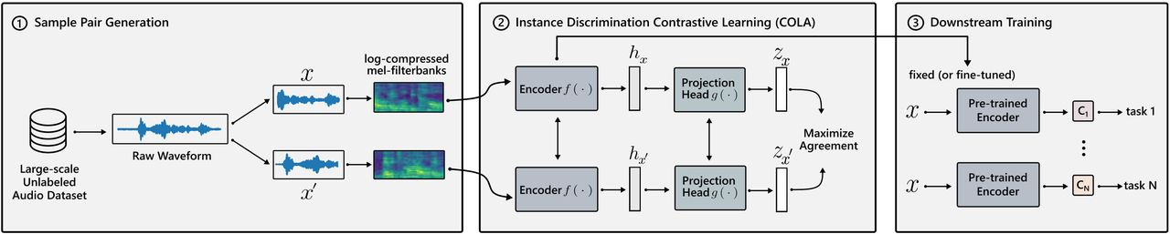
1. Spectrogram & Spectrogram
Notes:
- COLA Uses the same architecture as SimCLR,
- Positive pairs are formed from the segments of the same audio clip
- spectrogram are extracted and encoded to compute the contrastive loss

Slide 31
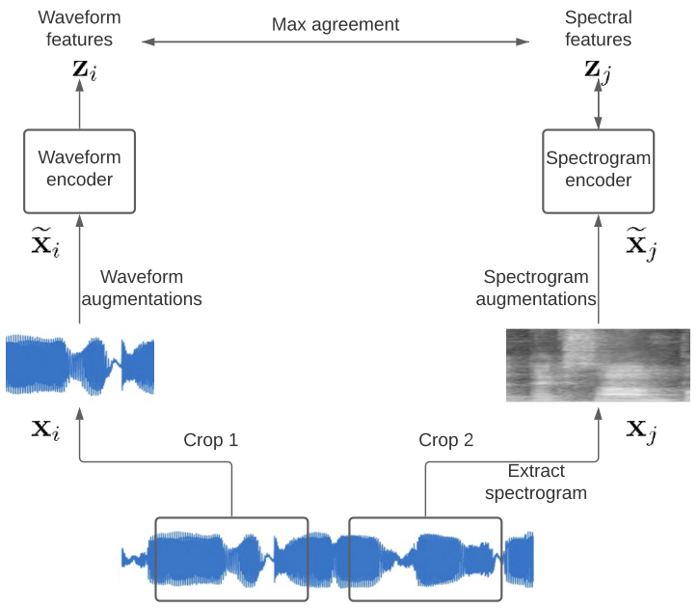
2. Spectrogram & Waveform
Notes:
And, Spectrogram versus waveform is another choice

Slide 32
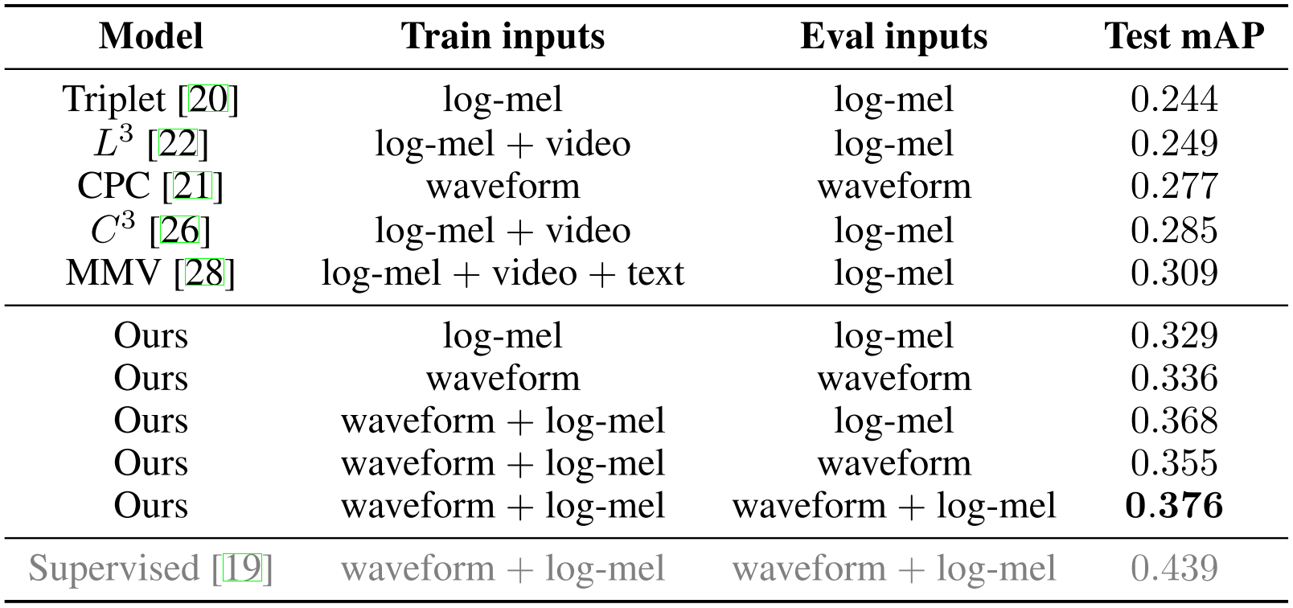
2. Results
log-mel == log-mel spectrogram
Notes:
- The results shows that contrastive learning beats all previous self-supervised baselines by a large margin, even the MMV with three modalities (we will talk about it later)
- and Spectrogram versus waveform performs the best

Slide 33
Outline
Preliminary
Supervised
Audio only
Audio + Video
Self-supervised
Audio only
Audio + Video
Audio + Video + Text
Notes:
Similar to their supervised counterparts, video could be leveraged in contrastive learning for sure

Slide 34
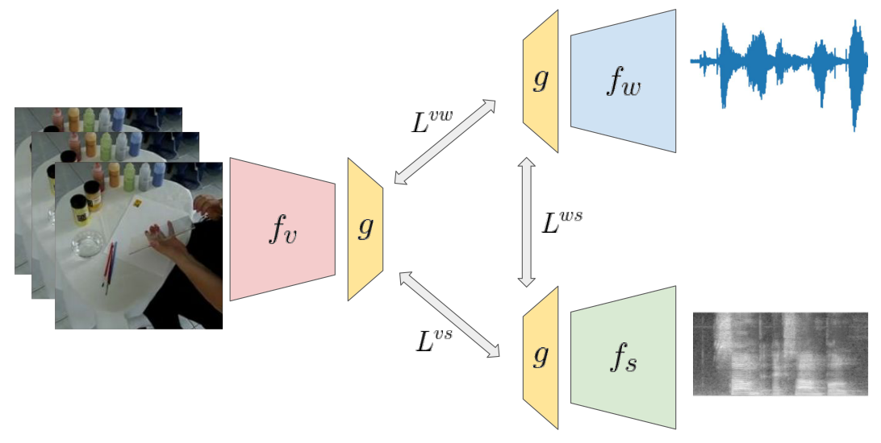
Spectrogram & Waveform & Video
Waveform
Video frames
Spectrogram
Notes:
The paper _____ added a video head on top of the multi-format contrastive framework and yields better performance as expected

Slide 35
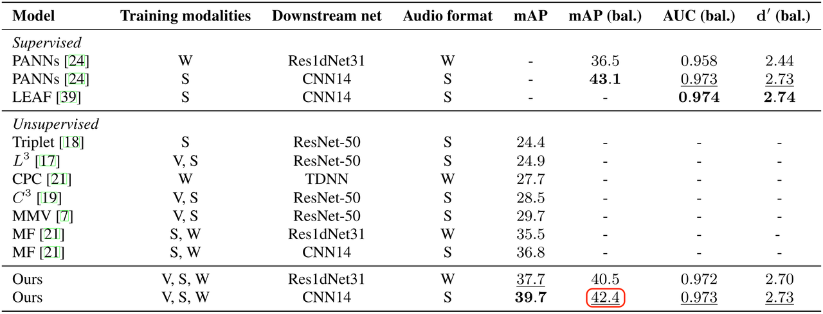
Results
Notes:
Their results are the state-of-the-art self-supervised method on AudioSet,
- even comparable with supervised CNN we‘ve mentioned before

Slide 36
Outline
Preliminary
Supervised
Audio only
Audio + Video
Self-supervised
Audio only
Audio + Video
Audio + Video + Text
Notes:
We are coming to the last part of this talk

Slide 37
Extending modalities to Text
Video Audio
(temporarily aligned)
Text?
How can we get Text aligned with Audio and Video? 🤔
ASR (Automatic Speech Recognition) from speech
Text labels from AudioSet (no longer self-supervised)
👆already applied in some papers
Audio caption datasets
…
Notes:
Since most of you guys are experts in natural language processing, can we exploit information from Text to enhance the performance of our models?
- The idea is good, however, there is a problem. Video and audio are temporarily aligned by nature
- but Text is not
- _______

Slide 38

Recall Spectrogram & Waveform & Video
“First, we should draw a straight line…”
Waveform
Text
Video frames
Spectrogram
Notes:
Recall the Audio plus Video paper we’ve mentioned before, can we just replace the waveform head with ASR text?

Slide 39
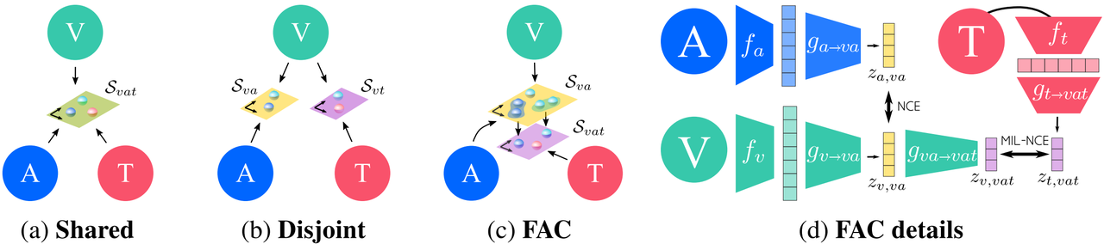
Projection strategies
Text, Video and Audio have different granularities (粒度)
Notes:
DeepMind says No.
- They claim that _______
In their paper they’ve proposed three projection strategies, shared, disjoint and Fine and Coarse projection
- They used the FAC to build their tri-modal contrastive learning architecture

Slide 40
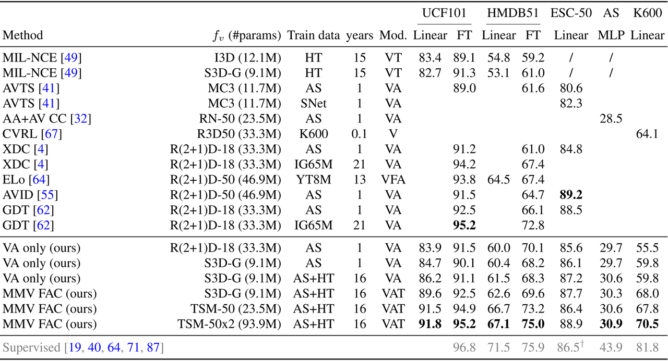
Results
Notes:
- However, Though their words are quite convincing, the results are not so promising.
- When text modality is added, parameters are 10 times more than two-modal settings, while performance only increases a bit

Slide 41
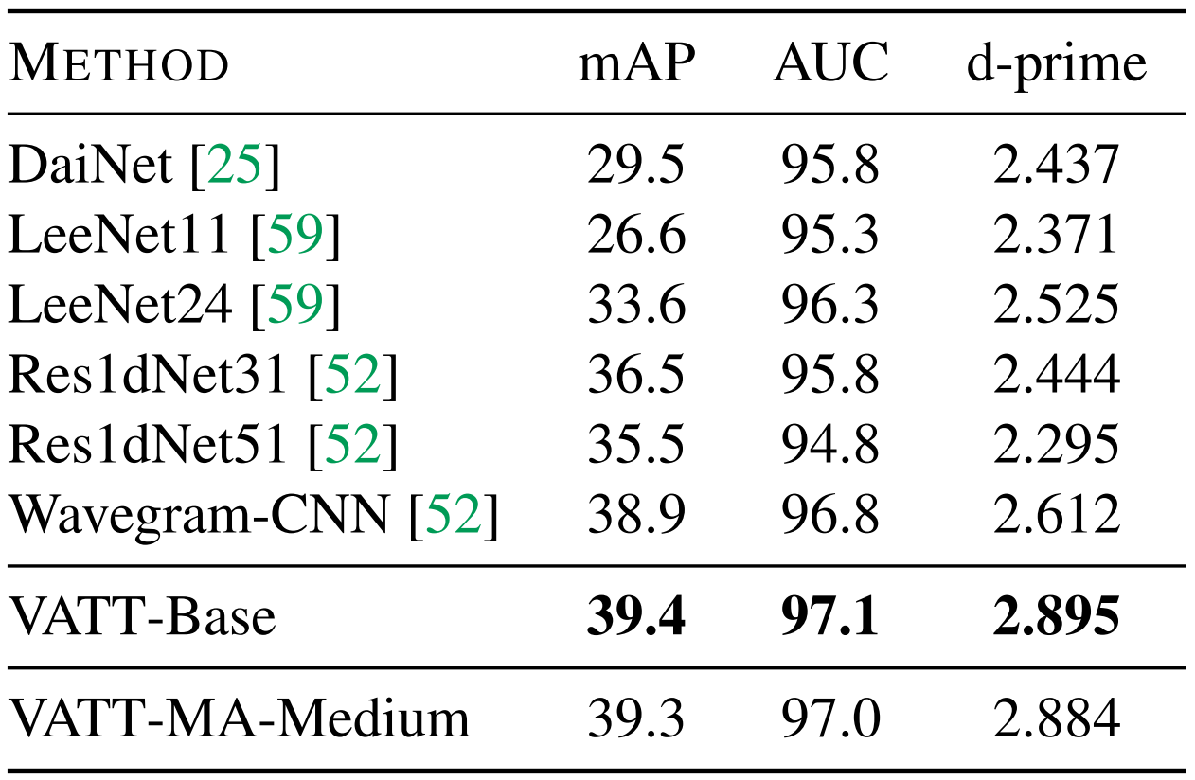
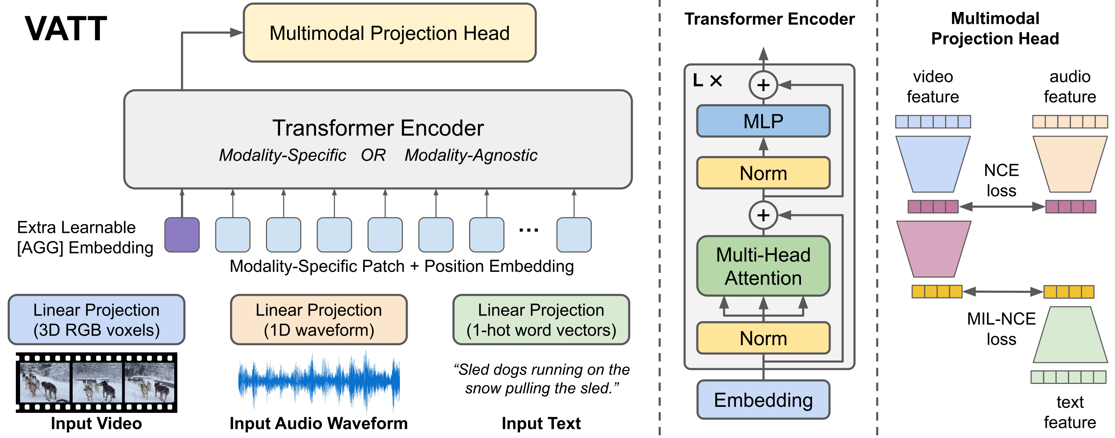
Results
MMV → VATT:
CNN → Transformers
Spectrogram → Waveform
Notes:
Later Google substitute their CNN with transformer, and uses waveform instead, achieving better results

Slide 42
Discussion
Visual information explicitly helps DL models to understand sound better (when used properly)
It is still unclear how we can exploit information from text modality to audio domain
AudioSet labels?
TV series transcripts?
Video description?
…
Notes:
In this talk we've witnessed that

Slide 43
Thanks!

